Slide 1

Comprehensive Diabetes Clinical Dataset
By:Dandre johnson

Slide 2
Introduction
Diabetes is a disease that occurs when blood glucose levels are too high. Glucose, a primary source of energy, comes from food, and insulin produced by the pancreas helps glucose enter the blood cells. With diabetes, the body does not produce enough insulin, causing glucose to remain in the bloodstream. Long-term effects of diabetes can damage the heart, kidneys, feet, and eyes, potentially leading to heart attacks and strokes.
Project goal: Use median imputation to handle missing values and identify contributing factors to diabetes
Notes:
Diabetes is a disease that occurs when blood glucose levels are too high. Glucose, a primary source of energy, comes from food, and insulin produced by the pancreas helps glucose enter the blood cells. With diabetes, the body does not produce enough insulin, causing glucose to remain in the bloodstream. Long-term effects of diabetes can damage the heart, kidneys, feet, and eyes, potentially leading to heart attacks and strokes. By integrating logistic regression into this dataset, we aim to answer the question of what the likelihood of developing diabetes is and identify contributing factors. The results can inform health officials and individuals, guiding future improvements in health management.

Slide 3
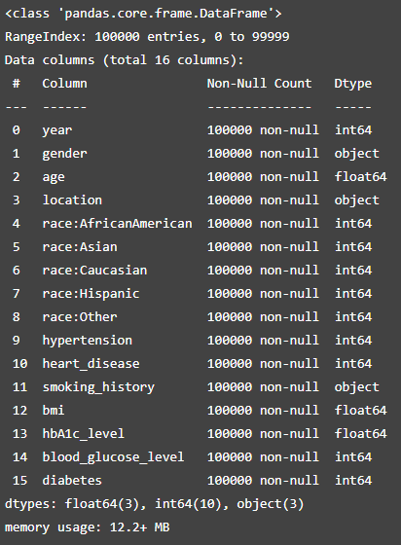
Dataset Description
Dataset includes 100,000 entries and 16 variables.
Variables include demographic and health-related information.
Data types: 11 categorical, 5 numerical.
No missing values.
Diabetes is the target variable, encoded as 0 (no diabetes) and 1 (diabetes).
Notes:
In this analysis, Diabetes will be the Target Variable used to find the correlation between the variables. The diabetes variable is going to be broken down into a diabetes Boolean value. This will be used when we fully break down the category variables into binary code that represents the same value. For the Diabetes variable 1 means the patients does have diabetes. 0 Means the patient does not have diabetes.
Breaking down the categorical variables would help us with the analysis when we need to find the specific gender, race, and smoking values.
The Smoking variable has missing values labeled as “ever.” We would replace the “ever” to “never” to fill in the missing value.
I used amputating the median in order to replace the missing value that’s in the age

Slide 4
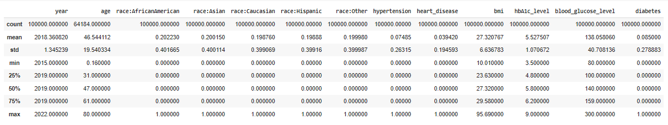
Data Explore
Figure : diabetes_dataset.xslx data summary

Slide 5
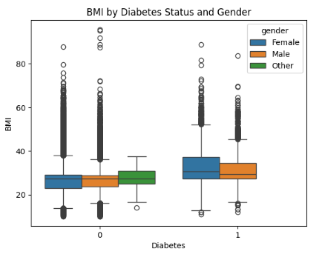
Data Explore

Slide 6
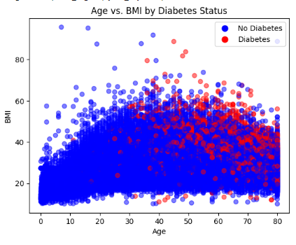
Data Explore
Figure Description:
The scatterplot displays the relationship between age and BMI for individuals in the dataset.
Notes:
Observations:
Individuals above 40 are more likely to have higher BMI values.
Younger individuals (under 40) exhibit more variability in BMI.
The scatterplot shows a cluster of higher BMI values for individuals with diabetes.
There are several outliers in the dataset, but they do not significantly affect the overall trend.

Slide 7
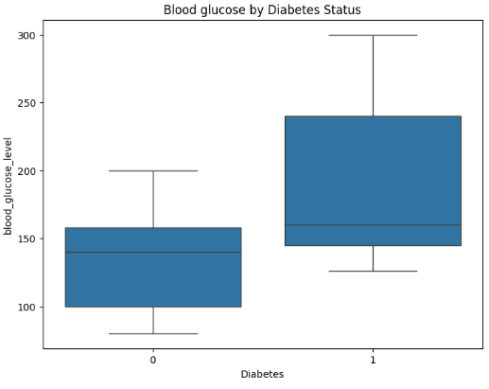
Data Explore
Figure Description:
The box plot illustrates the distribution of blood glucose levels for individuals with and without diabetes.
0 represents individuals without diabetes.
1 represents individuals with diabetes.
Notes:
Observations:
Individuals with diabetes (1) tend to have higher median blood glucose levels compared to those without diabetes (0).
There are noticeable outliers in both groups, but particularly among those with diabetes, indicating some individuals have significantly higher blood glucose levels.

Slide 8

Handling errors and missing values
Notes:
Categorical variables encoded into binary values.
Continuous variables normalized.
Missing values in smoking history variable replaced with "never."
Imputed missing age values with the median (47).

Slide 9
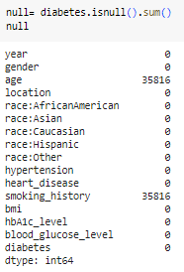
Finding Missing Values in the Dataset
Figure Description:
The figure shows the application of the .isnull() method to identify missing values within the dataset.
Notes:
Method:
.isnull() is used to check each entry in the dataset for missing values.
The method returns a boolean DataFrame indicating where missing values are present.
Observations:
The initial assessment reveals which columns contain missing values.
This step is crucial for data cleaning and ensuring the dataset is complete for analysis.

Slide 10
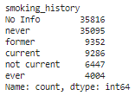
Smoking History Categories Breakdown
Figure Description: The figure illustrates how the Smoking History variable is transformed into separate columns representing different categories.
Notes:
Method:
The categorical variable Smoking_history is split into binary columns.
Each new column represents a different smoking status (e.g., never smoked, former smoker, current smoker).
Observations:
This transformation helps in better analysis by converting categorical data into a format suitable for statistical modeling.
Ensures that each smoking status is clearly represented and can be analyzed individually.

Slide 11

Smoking_history Data Cleaning
Figure: Smoking_history after we replaced the "ever" with the "never" status
Notes:
The figure demonstrates the data cleaning process applied to the Smoking History variable.
Step:
Replaced all occurrences of "ever" with "never" in the Smoking History column.
Reason:
The original dataset had "ever" entries which were ambiguous and needed to be standardized.
Replacing "ever" with "never" ensures consistency and clarity in the dataset.
Observations:
After replacement, the Smoking History data is more uniform and ready for further analysis.
This step was crucial in preparing the data for accurate modeling and analysis.

Slide 12
Handling incorrect values for the Age Variable
Method I choose was to impute the median
The median is able to condese the outliers in the dataset and help it be able to figure out the shpae of the datset so we could fins the righ tvaribales to compare
The median age in the datset was 47

Slide 13
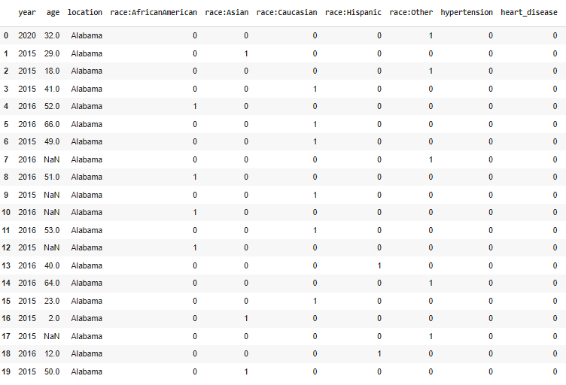
Dataset Before Age Imputation
Figure: The figure shows the dataset prior to the imputation of missing age values.
Notes:
Observations:
Several entries in the Age column have missing or incorrect values.
Missing values in the Age column can lead to inaccurate analysis and predictions.
The need for imputing missing values is highlighted by the gaps and inconsistencies in the data.

Slide 14
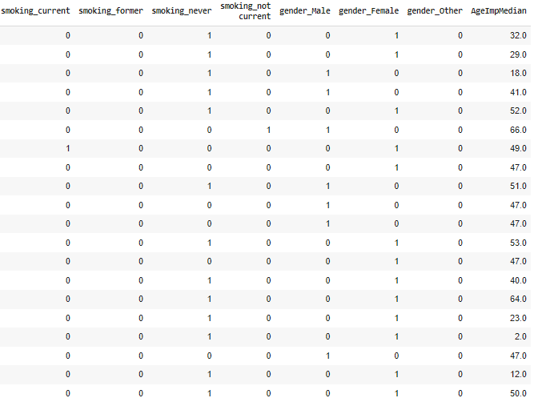
Dataset After Age Imputation
Figure: This figure shoes the dataset after the imputation of missing age
Notes:
Observations:
Missing age values have been filled using the median age.
The dataset is now more complete, with no missing values in the Age column.
Imputing with the median helps to reduce the impact of outliers and maintains the central tendency of the data.

Slide 15
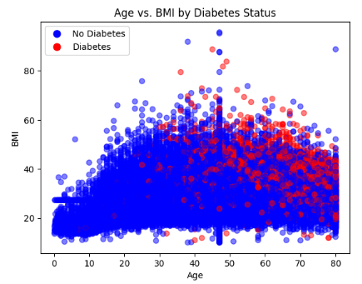
Scatterplot After Imputing the Median for the Age Variable
Figure: The figure displays the scatterplot of Age vs. BMI after imputing the median for missing age values.
Notes:
The scatterplot shows a more complete and continuous distribution of age values.
Imputing the median has addressed gaps in the dataset, making the analysis more reliable.
The overall trend and relationships between age and other variables are now clearer and more accurate.
Outliers are less pronounced, indicating a more normalized data distribution.

Slide 16
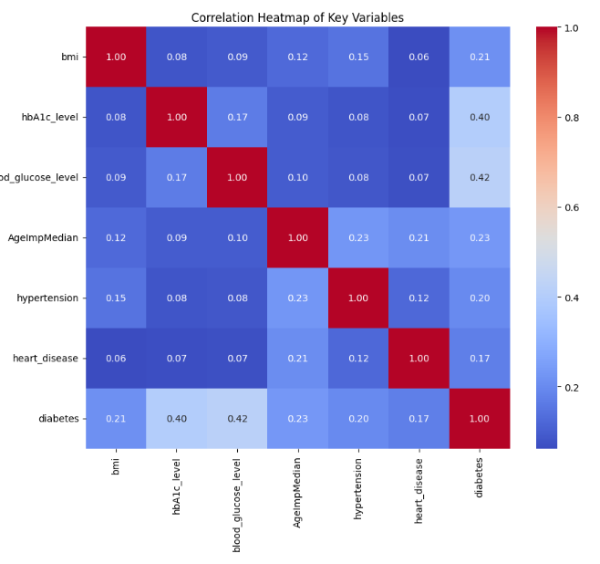
Correlation heatmap
Figure: The figure shows the correlation heatmap between the numeric values in the dataset.

Slide 17
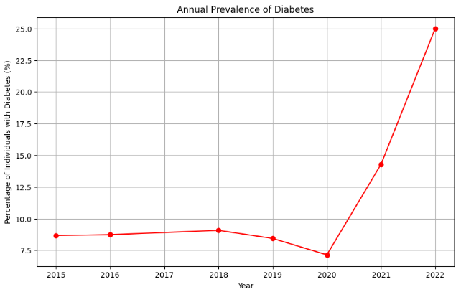
Prevalence of diabetes between 2015-2022
Figure: The figure shows the trend in diabetes rates from 2015 to 2022.
Notes:
Observations:
Overall, diabetes rates have been increasing over the years.
A noticeable dip in the prevalence of diabetes occurred in 2020.
The increase resumed after 2020, continuing the upward trend.
Possible reasons for the dip in 2020 could include changes in healthcare access, or lifestyle modifications.
This trend highlights the growing concern of diabetes as a public health issue and underscores the need for continuous monitoring and intervention strategies.

Slide 18
Conclusion
This insight should guide future public health policies and individual health strategies focusing on weight management, regular physical activity, and dietary adjustments to mitigate the risk of diabetes. This information should be spread through medical institutions and in schools to show the importance of health to keep your body healthy at an older age.
With this project I wanted to explore using regression models, but my time was limited to do the project. The research portion of the project was interesting as this is my first data science course at graduate level. The course and pace are interesting. Having statistical knowledge is beneficial regarding this project because it helped choose the desired variables and give a clue on the types of methods alternatives to use when I was stuck with my data.

